Slide 1
Non linear algorithms CART Algorithm

Slide 2
Decision trees are a flexible and very powerful machine learning method for regression and classification predictive modeling problems. In this chapter you will discover how to implement the CART machine learning algorithm from scratch step-by-step. After completing this chapter you will know:
ˆ How to calculate the Gini index for a given split in a decision tree.
ˆ How to evaluate different split points when constructing a decision tree.
ˆ How to make predictions on new data with a learned decision tree. Let’s get started.
18.1 Tutorial Dataset
In this tutorial we will work through a simple binary (two-class) classification problem for CART. To keep things simple we will work with a two input variables (X1 and X2) and a single output variable (Y ). This is not a real problem but a contrived problem to demonstrate how to implement the CART model and make predictions. The example was designed so that the algorithm will find at least two split points in order to best classify the training dataset. The raw data for this problem is as follows:
X1 | X2 | Y
2.771244718 | 1.784783929 | 0
1.728571309 | 1.169761413 | 0
3.678319846 | 2.81281357 | 0
3.961043357 | 2.61995032 | 0
2.999208922 | 2.209014212 | 0
7.497545867 | 3.162953546 | 1
9.00220326 | 3.339047188 | 1
7.444542326 | 0.476683375 | 1
10.12493903 | 3.234550982 | 1
6.642287351 | 3.319983761 | 1

Slide 3
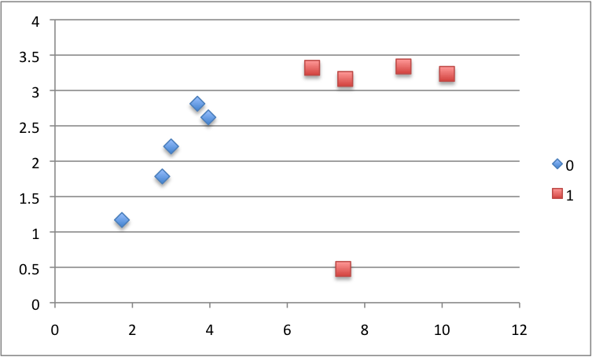

Slide 4
Figure 18.1: Classification And Regression Trees Tutorial Dataset.
Learning a CART Model
The CART model is learned by looking for split points in the data. A split point is a single value of a single attribute, e.g. the first value of the X1 attribute 2.771244718. Partitioning data at a split point involves separating all data at that node into two groups, left of the split point and right of the split point. If we are working on the first split point in the tree, then all of the dataset is affected. If we are working on say a split point one level deep, then only the data that has filtered down the tree from nodes above and is sitting at that node is affected by the split point.
We are not concerned with what the class value is of the chosen split point. We only care about the composition of the data assigned to the LEFT and to the RIGHT child nodes of the split point. A cost function is used to evaluate the mix of classes of training data assigned to each side of the split. In classification problems the Gini index cost function is used.
Gini Index Cost Function
We calculate the Gini index for a split point as follows:
Gini(split) = (p × (1 − p ))

Slide 5
For each class (k), for each group (left and right). Where p is the proportion of training instances with a given class in a given group. We will always have two groups, a left and right group because we are using a binary tree. And we know from our dataset that we only have two classes. Therefore we can calculate the Gini index of any split point in our dataset as the sum of:
Gini(split) = (left(0) × (1 − left(0))) + (right(0) × (1 − right(0))+ (left(1) × (1 − left(1))) + (right(1) × (1 − right(1))
Where left(0) is the proportion of data instances in the left group with class 0, right(0) is the proportion of data instances in the right group with class 0, and so on. The proportion of data instances of a class is easy to calculate. If a LEFT group has 3 instances with class 0 and 4 instances with calss 1 and the proportion with data instances of class 0 would be
7
0.428571429.
To get a feeling for Gini index scores, take a look at the table below. It provides 7
different scenarios for mixes of 0 and 1 classes in a single group.
Class | 0 | Class | 1 | Count | Class | 0/Count | Class | 1/Count | Gini
10 |  | 10 |  | 20 | 0.5 |  | 0.5 |  | 0.5
19 |  | 1 |  | 20 | 0.95 |  | 0.05 |  | 0.095
1 |  | 19 |  | 20 | 0.05 |  | 0.95 |  | 0.095
15 |  | 5 |  | 20 | 0.75 |  | 0.25 |  | 0.375
5 |  | 15 |  | 20 | 0.25 |  | 0.75 |  | 0.375
11 |  | 9 |  | 20 | 0.55 |  | 0.45 |  | 0.495
20 |  | 0 |  | 20 | 1 |  | 0 |  | 0
Gini(split) = (left(0) × (1 − left(0))) + (right(0) × (1 − right(0))+ (left(1) × (1 − left(1))) + (right(1) × (1 − right(1))

Slide 6
Listing 18.2: Sample Gini calculations.
It is easy to visualize these scenarios for one group, but the concepts translate to summing the proportions across the LEFT and RIGHT groups. You can see when the group has a 50-50 mix in the first row, that Gini is 0.5. This is the worst possible split. You can also see a case where the group only has data instances with class 0 on the last row and a Gini index of 0. This is an example of a perfect split. Our goal in selecting a split point is to evaluate the Gini index of all possible split points and greedily select the split point with the lowest cost. Let’s make this more concrete by calculating the cost of selecting different data points as our split point.
18.2.2 First Candidate Split Point
The first step is to choose a split that will become the stump or root node of our decision tree. We will start with the first candidate split point which is the X1 attribute and the value of X1 in the first instance: X1 = 2.771244718.
ˆ IF X1 < 2.771244718 THEN LEFT
ˆ IF X1 ≥ 2.771244718 THEN RIGHT
Let’s apply this rule to each X1 value in our training dataset. Below is the answer we get for each numbered instance in the dataset:

Slide 7
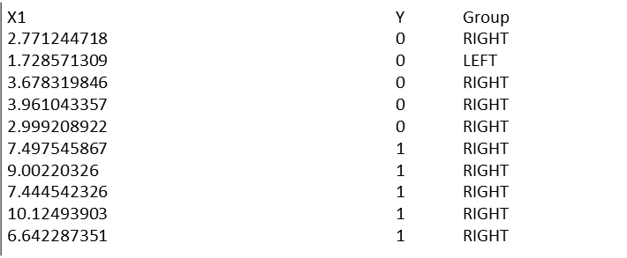

Slide 8
18.2. Learning a CART Model 79
How good was this split? We can evaluate the mixture of the classes in each of the LEFT and RIGHT nodes as a single cost of choosing this split point for our root node. The LEFT group only has one member, where as the RIGHT group has 9 members. Starting with the LEFT group, we can calculate the proportion of training instances that have each class:
ˆ Y = 0: or 1.0
ˆ Y = 1: or 0.0
The RIGHT group is more interesting as it is comprised of a mix of classes (we are probably going to get a high Gini index).
ˆ Y = 0: or 0.444444444
ˆ Y = 1: or 0.555555556
We now have enough information to calculate the Gini index for this split:
Gini(X1 = 2.7712) = (1.0 × (1 − 1.0)) + (0.0 × (1 − 0.0)) +
(0.444444444 × (1 − 0.444444444) +
(0.555555556 × (1 − 0.555555556))

Slide 9
Gini(X1 = 2.771244718) = 0.49382716
18.2.3 Best Candidate Split Point
We can evaluate each candidate split point using the process above with the values from X1 and X2. If we look at the graph of the data, we can see that we can probably draw a vertical line to separate the classes. This would translate to a split point for X1 with a value around
0.5. A close fit would be the value for X1 in the last instance: X1 = 6.642287351.
ˆ IF X1 < 6.642287351 THEN LEFT
ˆ IF X1 ≥ 6.642287351 THEN RIGHT
Let’s apply this rule to all instances, below we get the assigned group for each numbered data instance:
X1 | Y | Group
2.771244718 | 0 | LEFT
1.728571309 | 0 | LEFT
3.678319846 | 0 | LEFT
3.961043357 | 0 | LEFT
2.999208922 | 0 | LEFT
7.497545867 | 1 | RIGHT
9.00220326 | 1 | RIGHT
7.444542326 | 1 | RIGHT
10.12493903 | 1 | RIGHT
6.642287351 | 1 | RIGHT
 |  | Listing 18.4: Separation of Training Dataset by Bets Split.

Slide 10
18.3. Making Predictions on Data 80
There are 5 instances in each group, this looks like a good split. Starting with the LEFT group, we can calculate the proportion of training instances that have each class:
ˆ Y = 0: or 1.0
ˆ Y = 1: or 0.0
The RIGHT group has the opposite proportions.
ˆ Y = 0: or 0.0
ˆ Y = 1: or 1.0
We now have enough information to calculate the Gini index for this split:
Gini(X1 = 6.642287351) = (1.0 × (1 − 1.0)) +
(0.0 × (1 − 0.0)) +
(1.0 × (1 − 1.0)) +
(0.0 × (1 − 0.0))

Slide 11
or
Gini(X1 = 6.642287351) = 0.0 (18.6)
This is a split that results in a pure Gini index because the classes are perfectly separated. The LEFT child node will classify instances as class 0 and the right as class 1. We can stop there. You can see how this process could be repeated for each child node to build up a more complicated tree for a more challenging dataset.
18.3 Making Predictions on Data
We can now use this decision tree to make some predictions for all of the training instances. But we have already done that when we calculated the Gini index above. Instead, let’s classify some new data generated for each class using the same distribution. Here is the test dataset:
X1 | X2 | Y
2.343875381 | 2.051757824 | 0
3.536904049 | 3.032932531 | 0
2.801395588 | 2.786327755 | 0
3.656342926 | 2.581460765 | 0
2.853194386 | 1.052331062 | 0
8.907647835 | 3.730540859 | 1
9.752464513 | 3.740754624 | 1
8.016361622 | 3.013408249 | 1
6.58490395 | 2.436333477 | 1
7.142525173 | 3.650120799 | 1
 |  |  | Listing 18.5: Test Dataset.

Slide 12
Using the decision tree with a single split at, X1 = 6.642287351 we can classify the test instances as follows:
Y | Prediction
0 | 0
0 | 0
0 | 0
0 | 0
0 | 0
1 | 1
1 | 1
1 | 1
1 | 0
1 | 1
Listing 18.6: Predictions for Test Dataset.
Again, this is a perfect classification or 100% accurate.
18.4 Summary
In this chapter you discovered exactly how to construct a CART model and use it to make predictions. You learned how to:
ˆ Calculate the Gini index for a candidate split in a decision tree.
ˆ Evaluate any candidate split points using Gini index.
ˆ How to create a decision tree from scratch to make predictions.
ˆ How to make predictions on new data using a learned decision tree.
You now know how to implement CART from scratch. In the next chapter in you will discover the Naive Bayes machine learning algorithm for classification.

Slide 13

Poster: 198
Session Name: POS5
Day: Saturday 15 December 2018
Title: Artificial Intelligence in Healthcare
An integrated approach to healthcare delivery
Authors: Dr. Shyama Nagarajan, MHA AIIIMS, Managing Director, SahaManthran
Dr. Amitabh Dutta, MD Anesthesia, Sr. Consultant Sir Gangaram Hospital; Member Ethics Board, GRIPMER

Slide 14
Objectives
The symptomatology affecting us is hyper-variable. Current practice guidelines, the variability of experience in medicine, the translatability and two-way outcome tracking suffers. This can lead to sub-optimal handling of the disease. Patient outcome is unpredictable.
In ‘Machine Learning’, machine is made to learn the various parameters including, symptoms, behavior, biochemical and pathologic variables, among others. With help of a specially-designed software, the computer can develop effective learning.
AI needs machine-learning, facilitates heightened diagnostic sensitivity, specificity and treatment.
SahaManthran proposes a knowledge based initiative around medical virtualism to be utilized for co-creating machine-learning derived AI in Medicine.

Slide 15
Innovations in Medical and Biological Engineering
1950s and earlier
Artificial Kidney
X ray
Electrocardiogram
Cardiac Pacemaker
Cardiopulmonary bypass
Antibiotic Production technology
Defibrillator
1960s
Heart valve replacement
Intraocular lens
Ultrasound
Vascular grafts
Blood analysis and processing
1980s
Magnetic resonance imaging
Laser surgery
Vascular grafts
Recombinant therapeutics
Present day
Genomic sequencing and microarrays
Positron Emission tomography
Image guided surgery
1970s
Computer assisted tomography
Artificial hip and knee replacements
Balloon catheter
Endoscopy
Biological plant food engineering

Slide 16
New generations of medical technology products are Combination of different technologies which lead to the crossing of borders between traditional categories of medical products such as medical devices, pharmaceutical products or human tissues

Slide 17
What is Artificial Intelligence
Definition--“Use of a computer to model intelligent behaviour with minimal human intervention”
Machines & computer programs are capable of problem solving and learning, like a human brain.
Natural Language Processing (“NLP”) and translation,
Pattern recognition,
Visual perception and
Decision making.
Machine Learning (“ML”), one of the most exciting areas for Development of computational approaches to automatically make sense of data
Advantage of Machine
Can retain information
Becomes smarter over time
Machine is not susceptible to Sleep deprivation, distractions, information overload and short-term memory loss

Slide 18
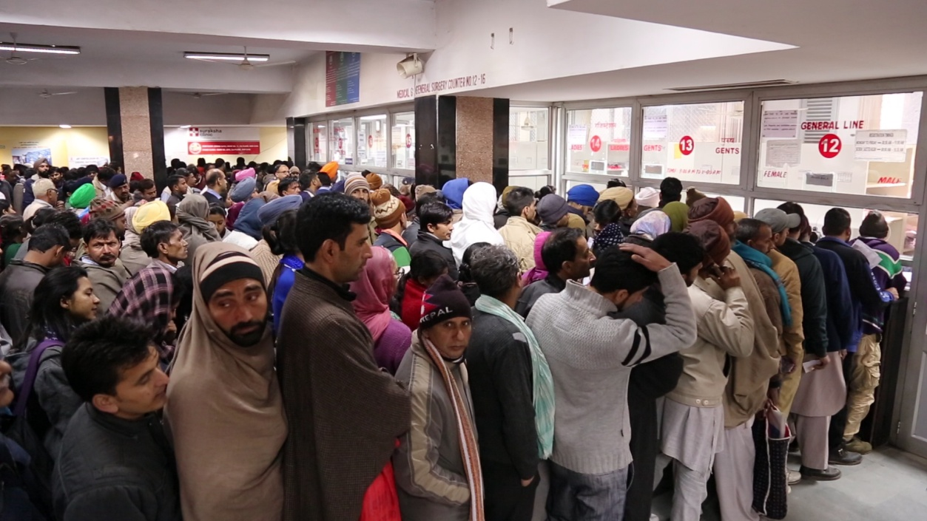
Highly repetitive work
Empower doctors
help them deliver faster and more accurate
Augment the professionals, offering them expertise and assistance.
Replace personnel and staffing in medical facilities, particularly in administrative functions,
Managing wait times & automating scheduling
“Deep-learning devices will not replace clinicians
The application of AI in medicine has two main branches:
A) Virtual branch
B) Physical branch.

Slide 19


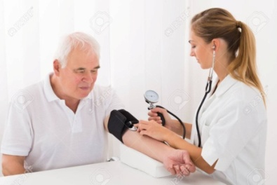
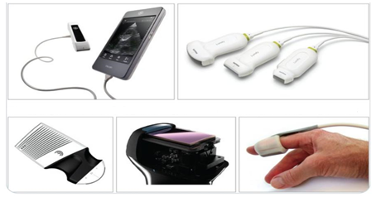


Artificial intelligence in medicine : The virtual branch
The virtual component is represented by Machine Learning, (also called Deep Learning)-mathematical algorithms that improve learning through experience.
Three types of machine learning algorithms:
Unsupervised (ability to find patterns)
Supervised (classification and prediction algorithms based on previous examples)
Reinforcement learning (use of sequences of rewards and punishments to form a strategy for operation in a specific problem space)

Slide 20
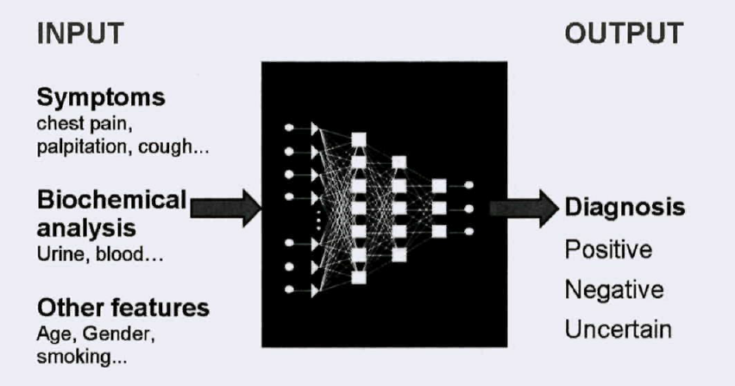
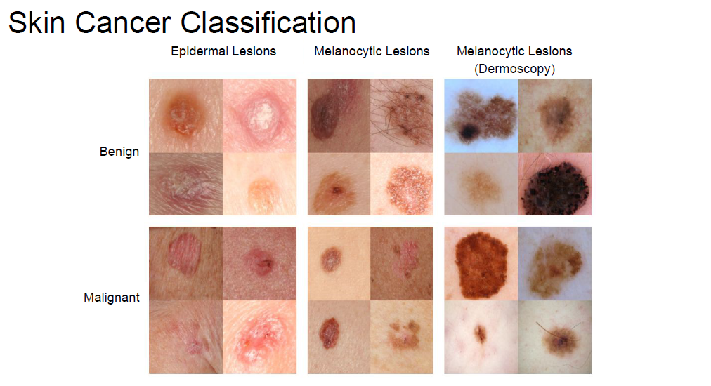
Benefits of Artificial intelligence
AI can definitely assist physicians
Clinical decision making - better clinical decisions
Replace human judgement in certain functional areas of healthcare (eg, radiology).
up-to-date medical information from journals, textbooks and clinical practices
Experienced vs fresh Clinician
24x7 availability of expert
Early diagnosis
Prediction of outcome of the disease as well as treatment
Feedback on treatment
Reinforce non pharmacological management
Reduce diagnostic and therapeutic errors
Increased patient safety and Huge cost savings associated with use of AI
AI system extracts useful information from a large patient population
Assist making real-time inferences for health risk alert and health outcome prediction
Learning and self-correcting abilities to improve its accuracy based on feedback.

Slide 21
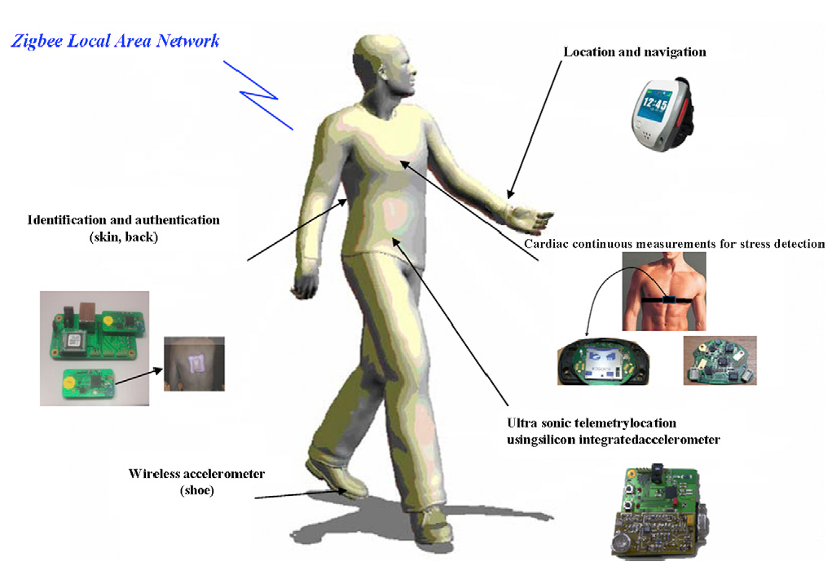
Artificial intelligence in medicine: The physical branch
It includes:
Physical objects,
Medical devices
Sophisticated robots for delivery of care (carebots)/ robots for surgery.

Slide 22
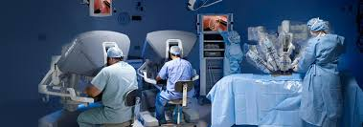
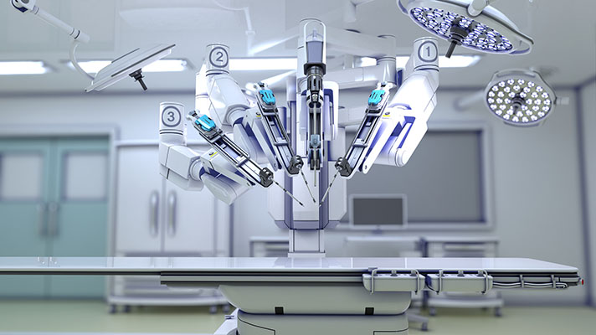
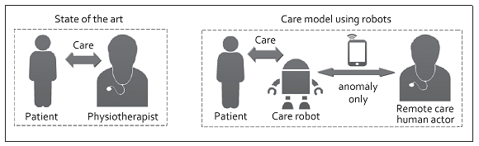
Use of robots to deliver treatment..robotic surgery
Use of robots to deliver treatment - Robotic surgery
Use of robots to monitor effectiveness of treatment

Slide 23
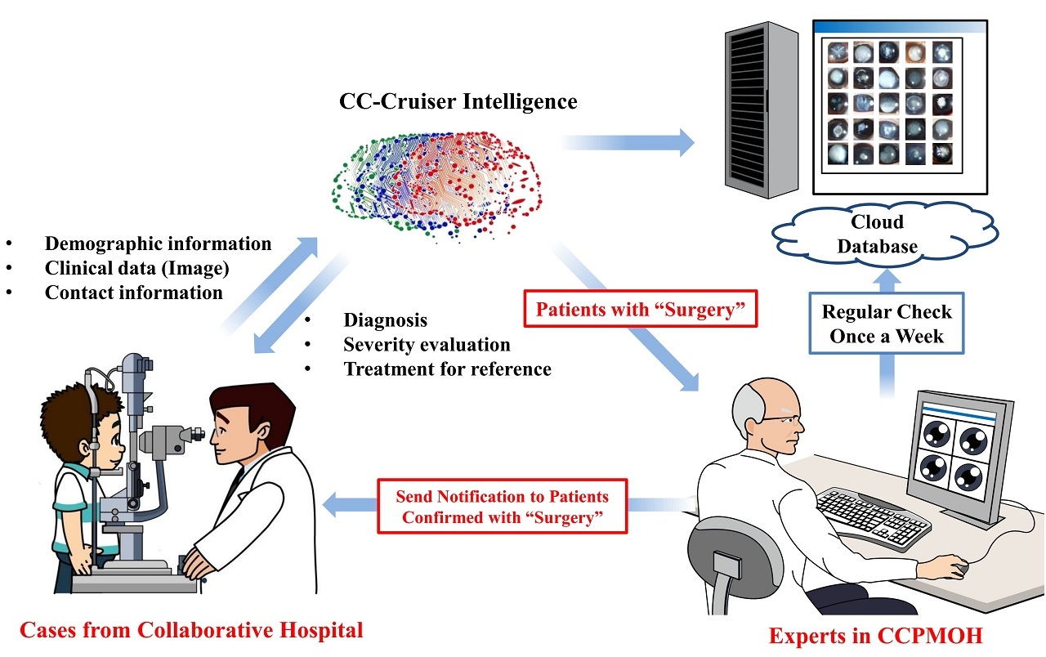
Growth drivers of AI in healthcare
Increasing individual healthcare expenses
Larger Geriatric population
Imbalance between health workforce and patients
Increasing Global Health care expenditure
Continuous shortage of nursing and technician staff. The number of vacancies for nurses will be 1.2 million by 2020
AI is and will help medical practitioners efficiently achieve their tasks with minimal human intervention, a critical factor in meeting increasing patient demand.

Slide 24
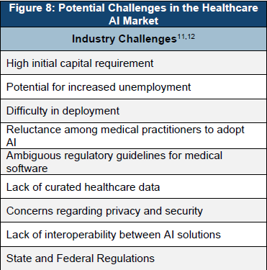
Potential challenges
Development costs
Integration issues
Ethical issues
Reluctance among medical practitioners to adopt AI
Fear of replacing humans
Data Privacy and security
Mobile health applications and devices that use AI
Lack of interoperability between AI solutions
Data exchange
Need for continuous training by data from clinical studies
Incentives for sharing data on the system for further development and improvement of the system. Nevertheless,
All the parties in the healthcare system, the physicians, the pharmaceutical companies and the patients, have greater incentives to compile and exchange information
State and federal regulations
Rapid and iterative process of software updates commonly used to improve existing products and services

Slide 25
Future Indian Scenario
Collaboration between medical and technical institutions
Stop working in silos
Remove Firewall of clinical load and hope of IPR
Government funding – more intelligent and result oriented rather than you pat – i pat
Scientific mafia or scientist Mafia
Current status of medical records
incommunicable silos of wasted information for the health system and for knowledge acquisition. Laboratories and clinics need to collaborate to accelerate the implementation of electronic health records
Data need to be captured in real-time, and institutions should promote their transformation into intelligible processes
New scientific and clinical findings should be shared through open-source, and aggregated data must be displayed for open-access by physicians and scientists and made automatically available as point-of-care information.
Integration and interoperability including ethical, legal and logistical concerns are enormous
Simplification, readability and clinical utility of data sets
Each result must be questioned for its clinical applicability.
Aim of increasing their clinical value and decreasing health costs
Electronic medical or health records
are essential tools for personalized medicine
Early detection and targeted prevention, again

